Slide 1
Capita Selecta SE
Online ticketing

Slide 2
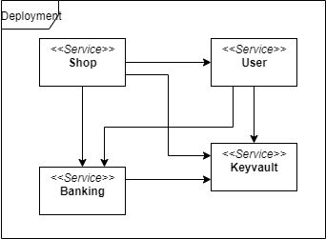
Modelling of the system

Slide 3
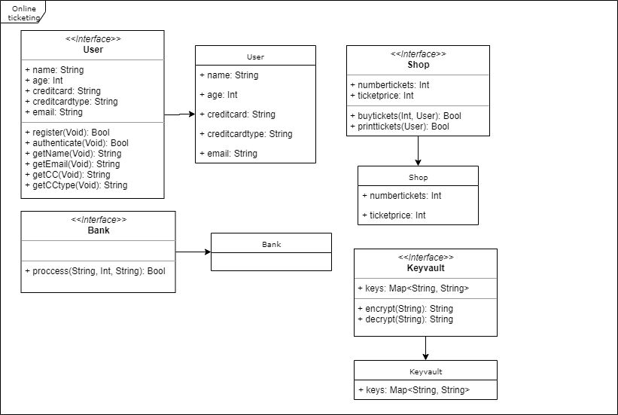

Slide 4
Sequence diagrams

Slide 5
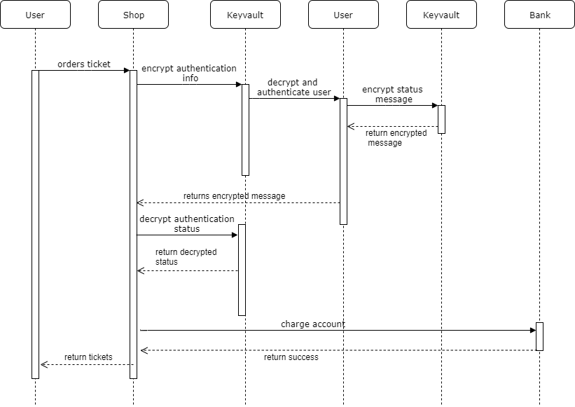

Slide 6
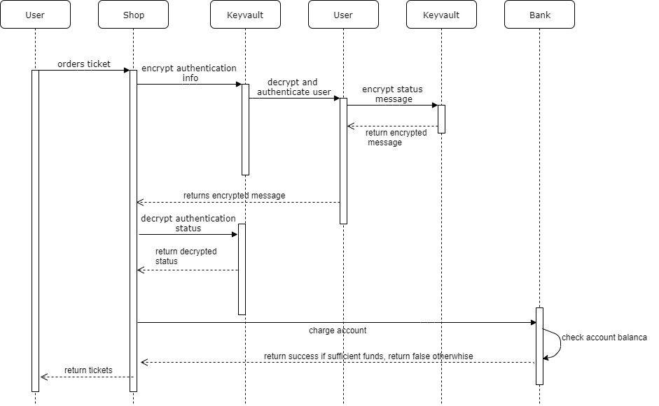

Slide 7
Model callibration
Banking duration: 10-60, 20-80 and 50-150 time units per call
Keyvault duration: 40-50 time units
User duration: 10-29 time units registration, 30-49 time units printing tickets
Shop duration: no explicit time added

Slide 8
Plan phase 2
Docker
4 services: User, Shop, Bank, Keyvault
User service: registering and authentication
Shop service: placing orders and handling orders
Bank service: process payments
Keyvault service: encrypt and decrypt messages from other services

